Slide 1
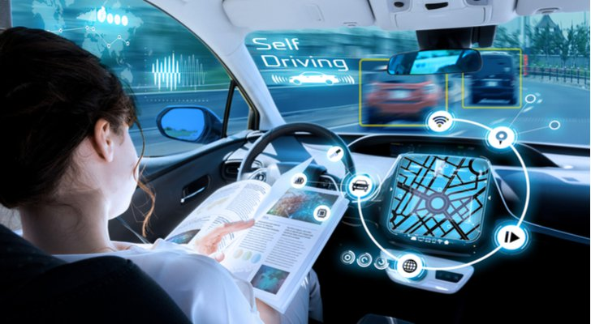
Training and Testing an Autonomous Driving System
Michael Martinez

Slide 2
Autonomous Driving System (ADS)
At the heart of every ADS or self-driving car is the ability to sense its environment. In fact, this ability is the most important feature in driving an automobile. We humans almost take this ability for granted when we get behind the wheel, but for an ADS the process of learning this task and implementing it takes years of optimization and incorporation of several technologies.

Slide 3

Project Goal
Train a behavioral-cloning NVIDIA Convolutional Neural Network to sense its environment and predict steering angles to stay in the center of a lane.

Slide 4
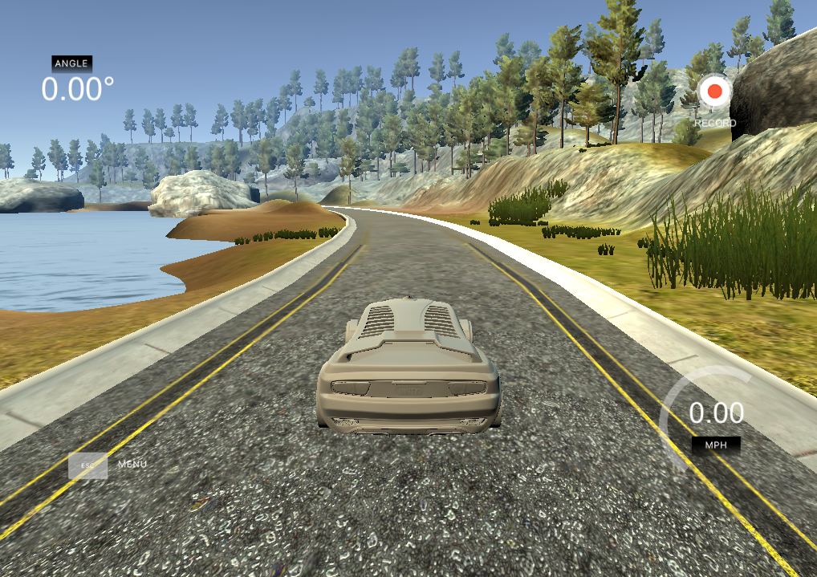
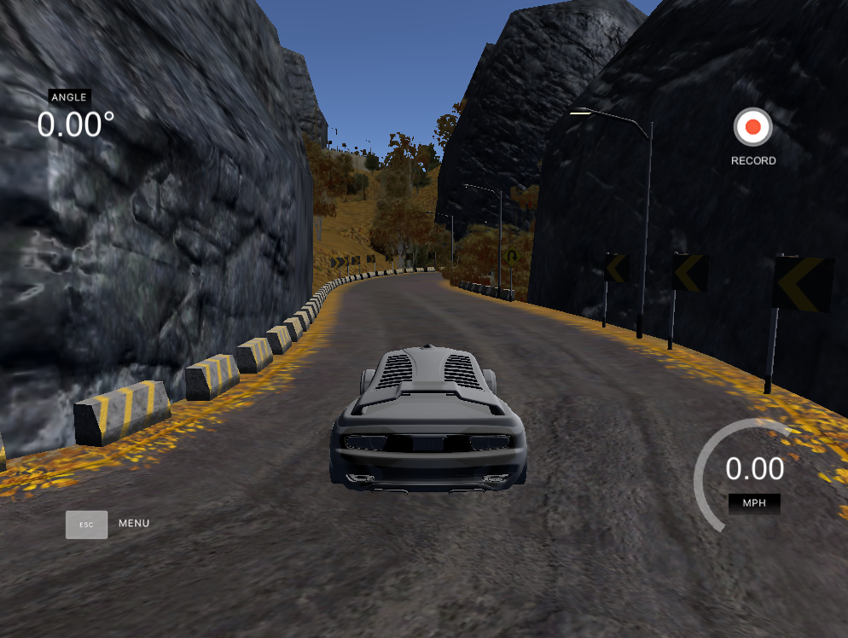
Simulator
To facilitate this project, I use Udacity’s Self-Driving Car simulator.
Collect Data with the training/recording setting
Train the model in the autonomous setting
Has 2 tracks- a lake and mountain

Slide 5
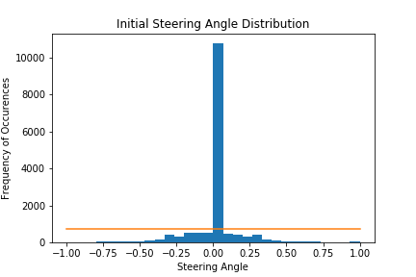
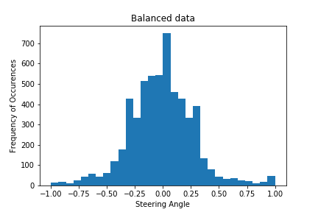
Data Processing

Slide 6
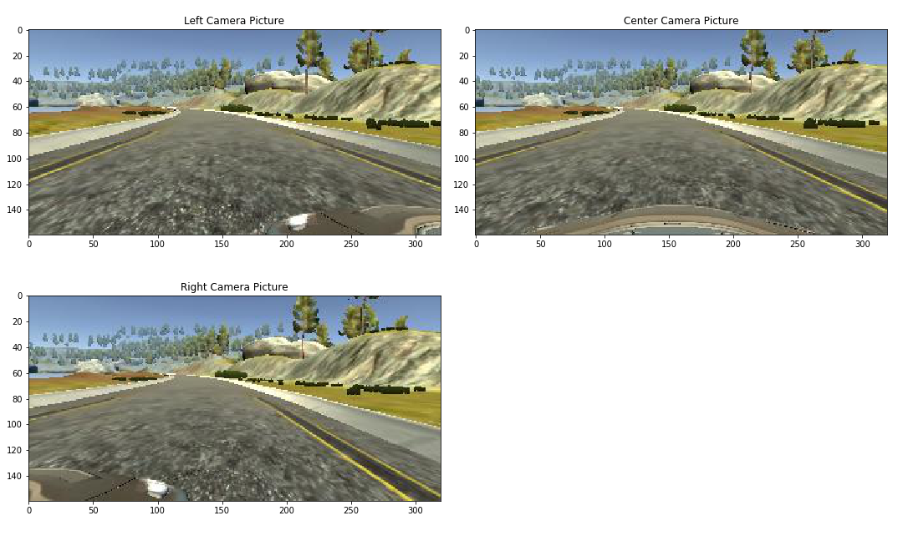
Captured Images
Images as captured by the car’s 3 cameras

Slide 7
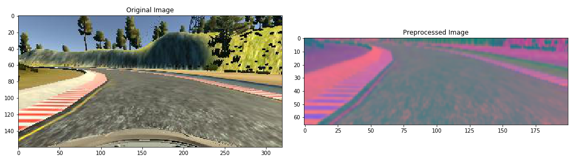
Preprocessing Images for Model
Crop image to exclude irrelevant data and convert RGB color scheme to YUV (popular and NVIDIA ADS color scheme)

Slide 8
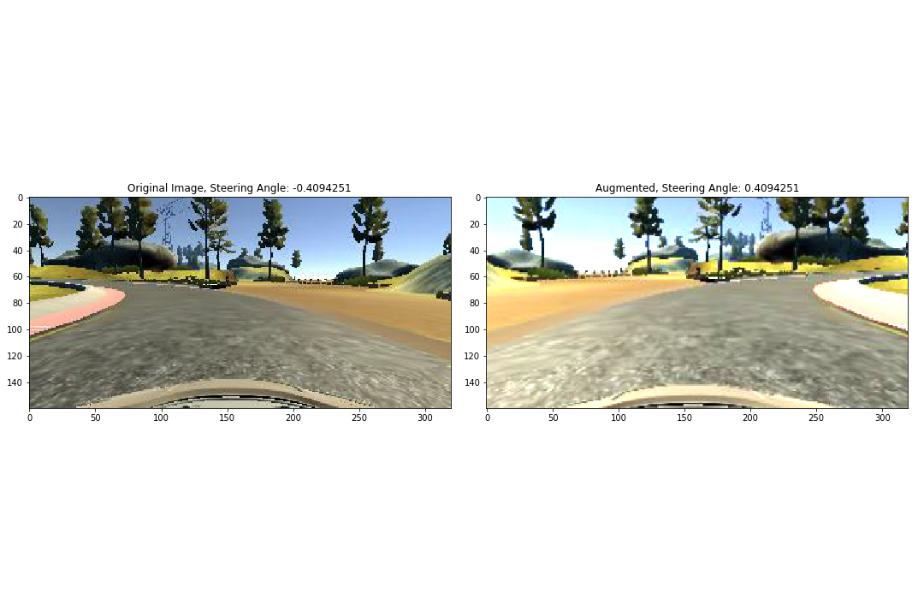
Augmenting Images
Implement image augmentation to optimize model generalization
Zoom, Pan, Sharpen, Darken, Brighten, Flip

Slide 9
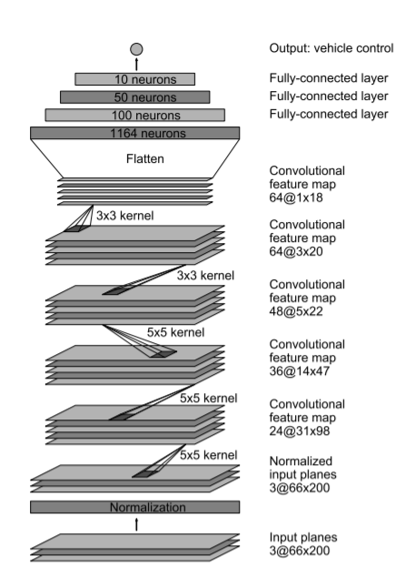
NVIDIA Model

Slide 10
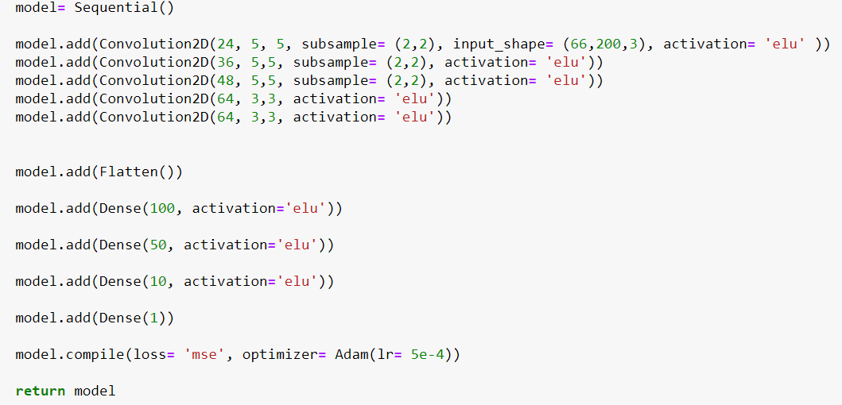
Implemented Model

Slide 11
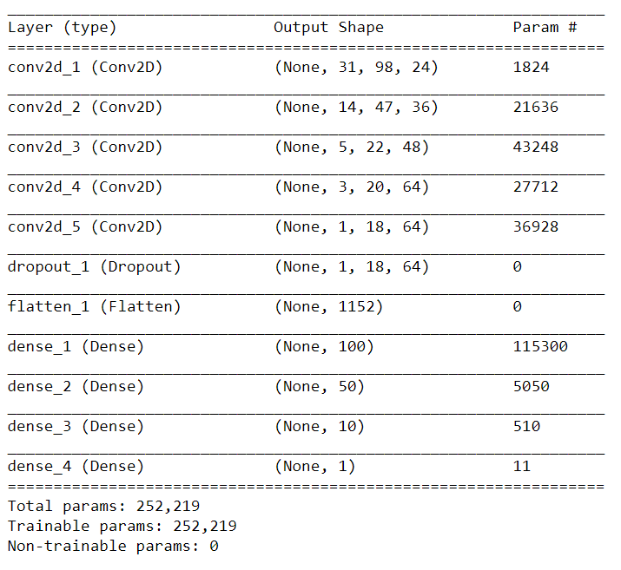
Model Summary
The Model Summary gives an overview of the model architecture and data transformation(shape)

Slide 12
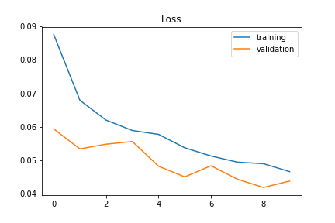
Model Evaluation
The training and validation loss plot shows a good relationship between the 2 datasets.

Slide 13
Lake Track Simulation
https://drive.google.com/open?id=1sQspYS0nLOOsj5a6ARhR3p1sIMykF4W2

Slide 14
Mountain Track Simulation
https://drive.google.com/open?id=1TpnWA_0R_C5FVdLO3gViW5TYZikkP112

Slide 15
Going Further
This project serves as a great foundation for a powerful ADS system
Next steps would be to increase training parameters to further optimize model performance on more and more generalized tracks
Left and right camera images
Speed
Throttle
Reverse
Break

